Slide 1
Fake News Detection & Verification Tool

Slide 2
Introduction
The rapid spread of misinformation on social media threatens public trust, safety & democracy.
Manual fact-checking is slow and cannot scale in real time.
AI-powered detection provides automated, accurate, fast credibility assessment.
This project uses NLP, Transformers, Deep Learning, and Fact-Checking APIs to analyze news and verify claims.

Slide 3
Problem Statement
Fake news spreads faster than verified information.
Affects elections, health decisions, public safety, and economy.
No unified tool to classify, verify, and explain misinformation.
Need for automated, explainable, scalable detection system.

Slide 4
Project Objectives
Build an AI tool to classify news as Real, Suspicious, Fake.
Enable real-time claim verification using trusted APIs.
Provide Explainable AI by highlighting suspicious phrases.
Support multilingual inputs and user-friendly interface.

Slide 5
Technologies Used
1. NLP Technologies
Tokenization, Stopword removal
Lemmatization (spaCy, NLTK)
Named Entity Recognition (NER)
Dependency Parsing
2. Machine Learning / Deep Learning
Transformer models: BERT, RoBERTa, DistilBERT
Fine-tuning for classification

Slide 6
Technologies Used
3. APIs & Databases
Google Fact Check Tools API
PolitiFact API
SQL / NoSQL storage
4. Web & Backend Technologies
Flask / FastAPI
JWT Authentication
Docker deployment

Slide 7
System Outcomes
Automated detection with probability score (0–1).
Real-time verification of factual claims.
Explainable results with highlighted keywords.
Source credibility scoring.
Multilingual misinformation detection.
Interactive dashboard for results.

Slide 8
Module Overview
Module 1 — User Authentication
Registration, login, JWT security
Module 2 — Input Processing
Text upload / URL fetch
Preprocessing pipeline
Module 3 — NLP & Feature Extraction
NER, POS tagging, Lemmatization

Slide 9
Module Overview
Module 4 — Classification Module
Transformer-based fake news classifier
Module 5 — Claim Verification
Fact-checking API integration
Module 6 — Explainability & Visualization
Suspicious text highlighting
Module 7 — Admin Dashboard
Manage sources and monitor usage

Slide 10
Technology Analysis (Detailed)
Why Transformers?
High accuracy
Understand context
Perform well in misinformation detection
Why Fact-Checking APIs?
Real-time verification
Reliable, trusted sources
Automated claim matching

Slide 11
Technology Analysis (Detailed)
Challenges
Sarcasm & irony detection
Domain-specific misinformation
Low-resource languages
Delayed fact-checking data
Advantages
Faster than human fact-checking
Scalable
Explainable & transparent

Slide 12
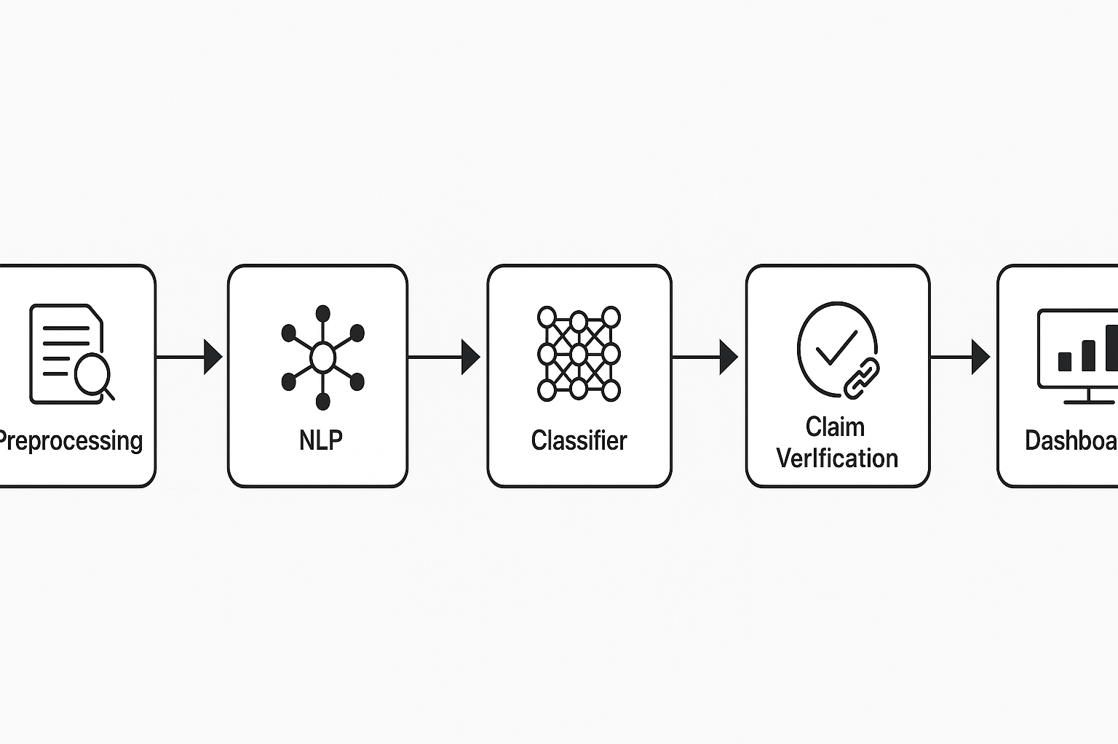
Architecture Diagram
Include diagram showing:
User → Preprocessing → NLP → Classifier → Claim Verification → Dashboard (based on PDF content)

Slide 13
Database / Schema Overview
Users Table
Articles Table
Processed Text Table
Entities Table
Verification Results Table

Slide 14
Conclusion
AI-powered Fake News Detection is essential in the digital age.
Combines NLP + Deep Learning + Fact Verification to ensure content integrity.
Helps build a safer, more informed digital society.

